Slide 1
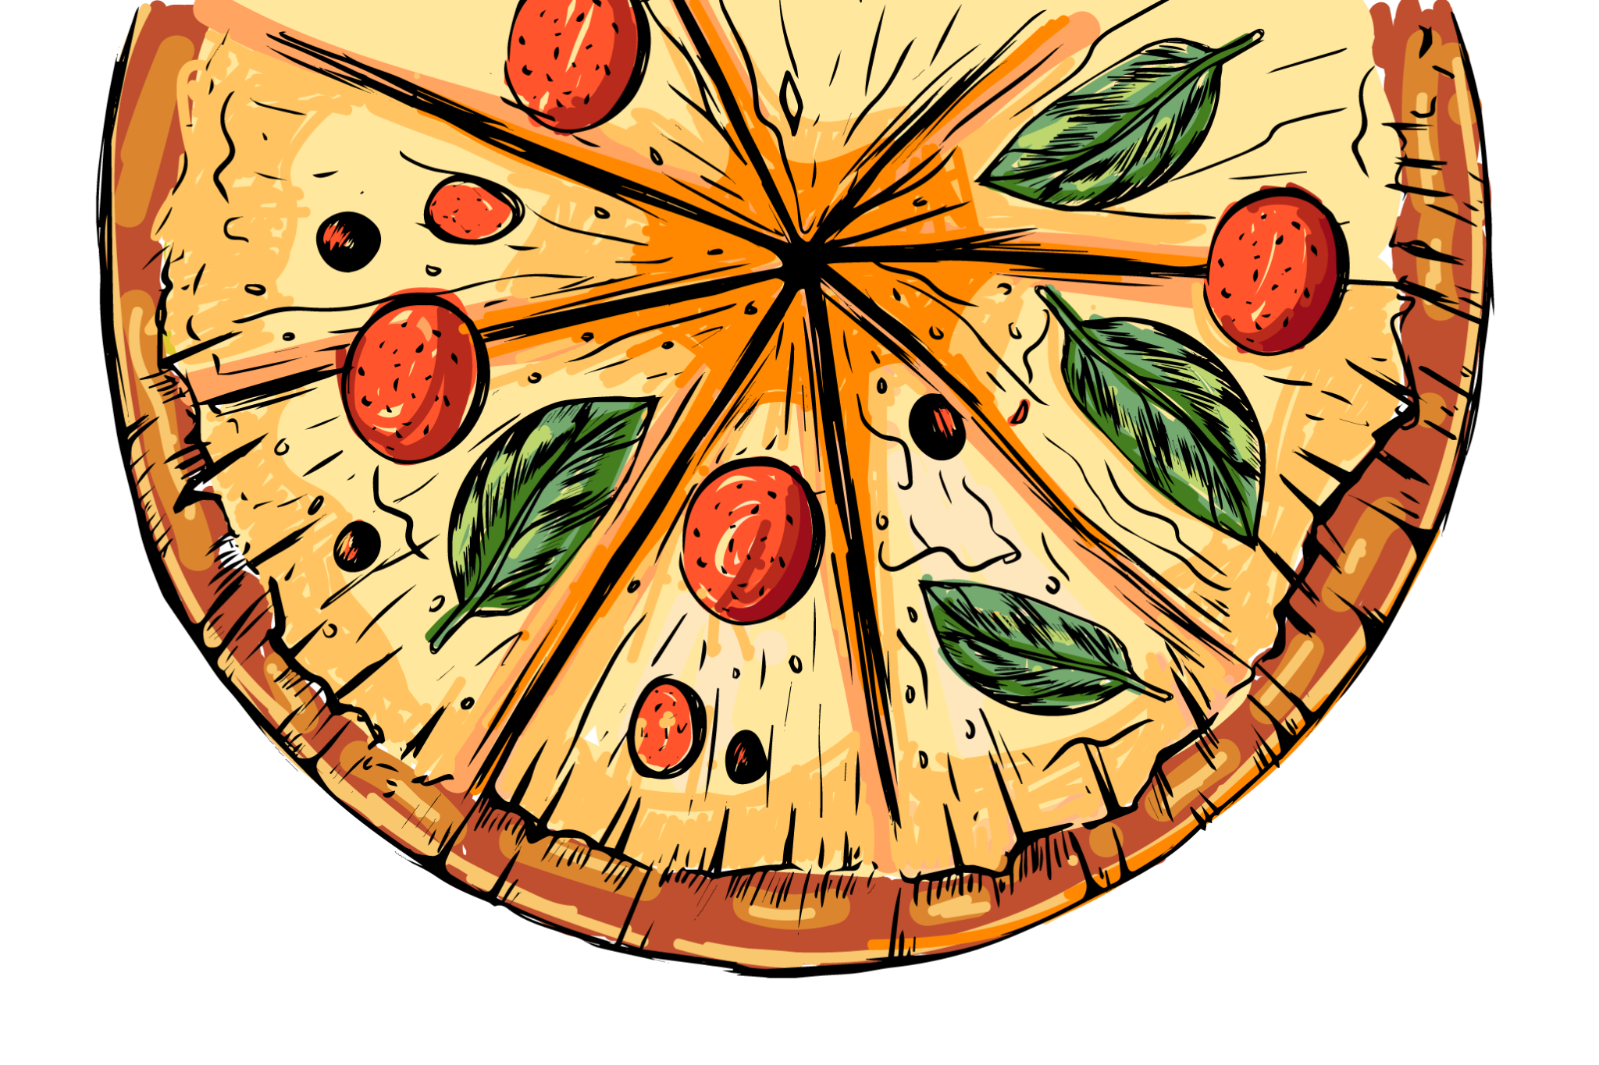
PIZZA HUT
www.slidesgo.es
ANALYSIS
PRESENTED BY JANJALA YASWANTH SAI

Slide 2


INTRODUCTION
The modern pizza, featuring tomato sauce, mozzarella, and basil, is often associated with Pizza Margherita, created in honor of Queen Margherita of Savoy in 1889.

Slide 3


“Pizza is a circle. It has no beginning and no end. And that's how I like my life to be.”
—SOMEONE FAMOUS

Slide 4

TABLE OF CONTENTS
BUSINESS
&
RECOMMENDATIONS
OBJECTIVE
AND
SCOPE
ANALYSIS
&
INSIGHTS
DATASET OVERVIEW
TOOLS USED
ANALYSIS OF THE DATA

Slide 5
DATASET OVERVIEW
ORDERS
ORDER
DETAILS
PIZZA
TYPES
PIZZAS
Columns in orders table
Columns in order details table
Columns in pizzas table
Columns in pizza types table
Order_id: Unique identifier for each order.
Date: Date when the order was placed.
Time: Time when the order was placed.
Order_details_id: Unique identifier for the detail entry.
order_id: Foreign key from orders.
Pizza_id: Foreign key from pizzas.
Quantity: Number of pizzas ordered.
Pizza_id: Unique identifie for a specific variant.
Pizza_type_id:Foreign key from pizza_types.
Size: Size of the pizza(S. M. L).
Price: Price based on size
Pizza_type_id: Unique Identifier for a pizza type.
Name: pizza name (e.x., “Margerita”).
Category: Like Veggie, Chicken.
Ingredients: List of Ingredients used

Slide 6
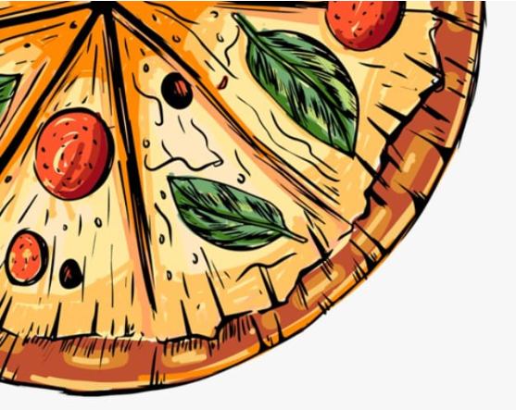
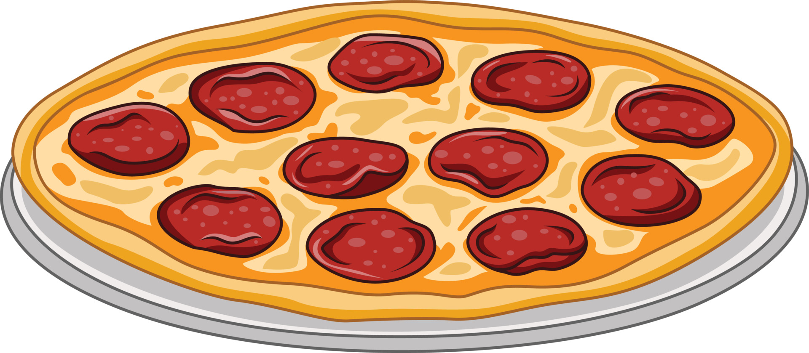

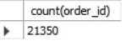
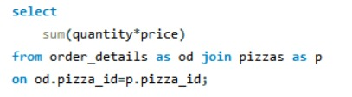
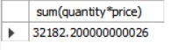
Total Orders Count
The Total numbers of orders are 21,350
Total Revenue
Total Revenue Generated for this is 32182. 200000000026

Slide 7
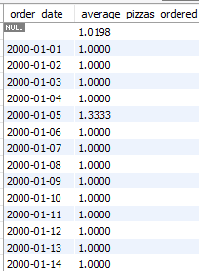
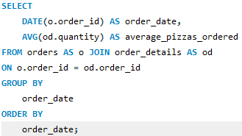
Average Daily Pizzas Ordered

Slide 8
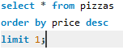
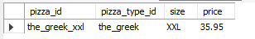
Most Expensive Pizza
Most Expensive pizza is the_Greek_xxl with a price of 35.95

Slide 9
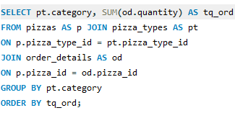
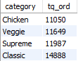
Pizza Quantity by Category
The Most ordered pizza Category is Classical with an order quantity of 14888 which accounts for 30% of total pizzas ordered across all categories

Slide 10
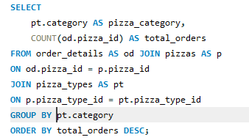
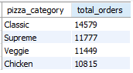
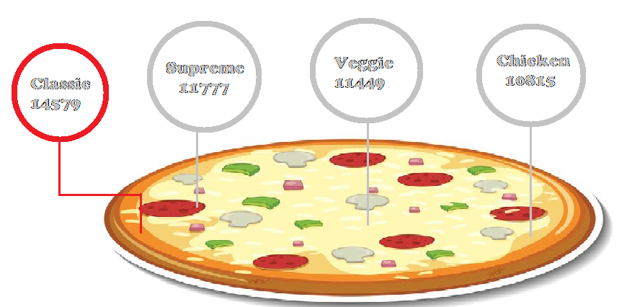
Pizza Distribution by Category

Slide 11
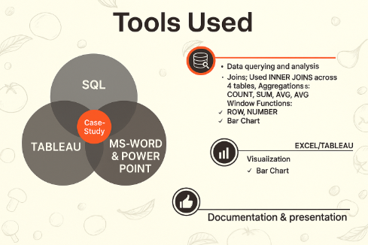
✓ Pie Chart

Slide 12
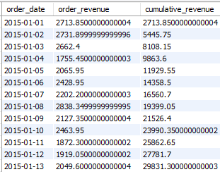
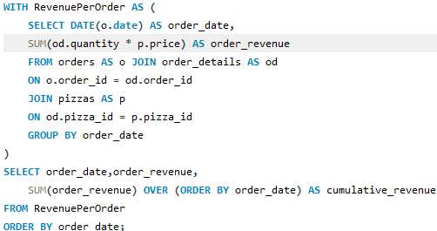
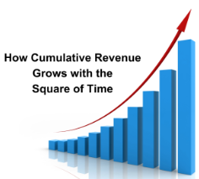
Cumulative Revenue Over Time

Slide 13
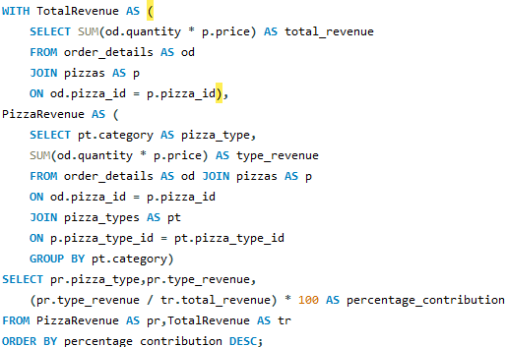
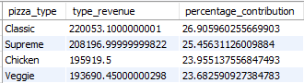
Revenue Contribution By Pizza Types
The Revenue bought by thai chicken pizza,
Barbeque Chicken Pizza and California
Chicken Pizza are 43434.25,42768,41409.5
and these are the major contributors and
told about 5.31%,5.23% and 5.06% of the
Revenue Contribution

Slide 14

25,00,000
Big numbers catch your audience’s attention

Slide 15
CAUSES & EFFECTS
ENVIRONMENT
PEOPLE
MEASUREMENT
Consumption through ingredient sourcing
Eating pizza frequently can lead to various health issues
Accurate measurements are crucial for pizza making
PROBLEM OR GOAL
Pizza often contains a lot of cheese
Dough Handling, Baking, Toppings
machines in pizza production can lead to increased efficiency
MATERIALS
METHODS
MACHINES

Slide 16

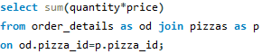
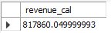

QUESTION & ANSWER
QUESTION
2) Revenue Calculation
-- Calculate the total revenue from pizza sales.
ANSWER OUTPUT

Slide 17

Business & Recommendations
1) Menu Optimization & Promotions
2) Data-Driven Growth Strategies
3) Operational Improvements
Bundle High-Demand Items :
Create Combos like ”Classic dix + Drink + Dessert” or “Family XL Pack” to increase order value.
Market Greek XXL as a “Gournet” option for Special occasions.
Reward frequent buyers with points for top pizzas (e.x., “ Order Classic dlx 3X, get 1 free
Premium Pizza Strategy :
Loyalty & Retention :
Inventory & Waste Reduction
Stock more Large (L) bases and Classic/Supreme toppings to match demand.
Reduce low-selling ingredients (e.x., niche Chicken variants).
Survey customers on Chicken pizza preferences to improve recipes.
Test smaller sizes for premium pizzas (e.x., Greek s) to attract solo buyers.
Customer Feedback Loop

Slide 18
Analysis & Insights
Customer Preferences & Sales Trends
Classic (30% of orders, 14888 pizzas) is the most popular, followed by Supreme, Veggie, and Chicken (least ordered).
Customers prefer traditional & familiar flavors over experimental ones.
Top pizzas :
Classic dix (2.453 orders), Bbq_ckn, Hawaiian, and Thai_ckn dominate sales.
Premium pizzas :
Greek_XXl (₹35.95) is the most expensive, followed by Greek_xl and brie_carre_s,representing a potential high-margin product segment.
Size Preferences :
Large (L) is the most ordered size (38.1%, 18.526 pizzas) followed by M
2) Order Timing & Demand Peaks
Peak Hours (Lunch & Dinner):
12 PM (2520 orders, 11.8%), 1PM (2,455), 5PM-7PM (-2300-2400 orders each).
3) Revenue & Profitability
Total Revenue : ₹8,17,860.05 from 21350 orders.
High Margin Opportunities : Premium pizzas (Greek_XXL, brie_carre_s) can drive profitability despite lower volume.

Slide 19

SCAN THIS QR CODE TO OPEN THE PIZZA HUT ANALYSIS DASH BOARD
CLICK ON THE LINK BELOW
https://public.tableau.com/app/profile/yaswanth.sai.janjala/viz/MYDASHBOARD_17557717862880/Dashboard1
Notes:
Fifyid8

Slide 20

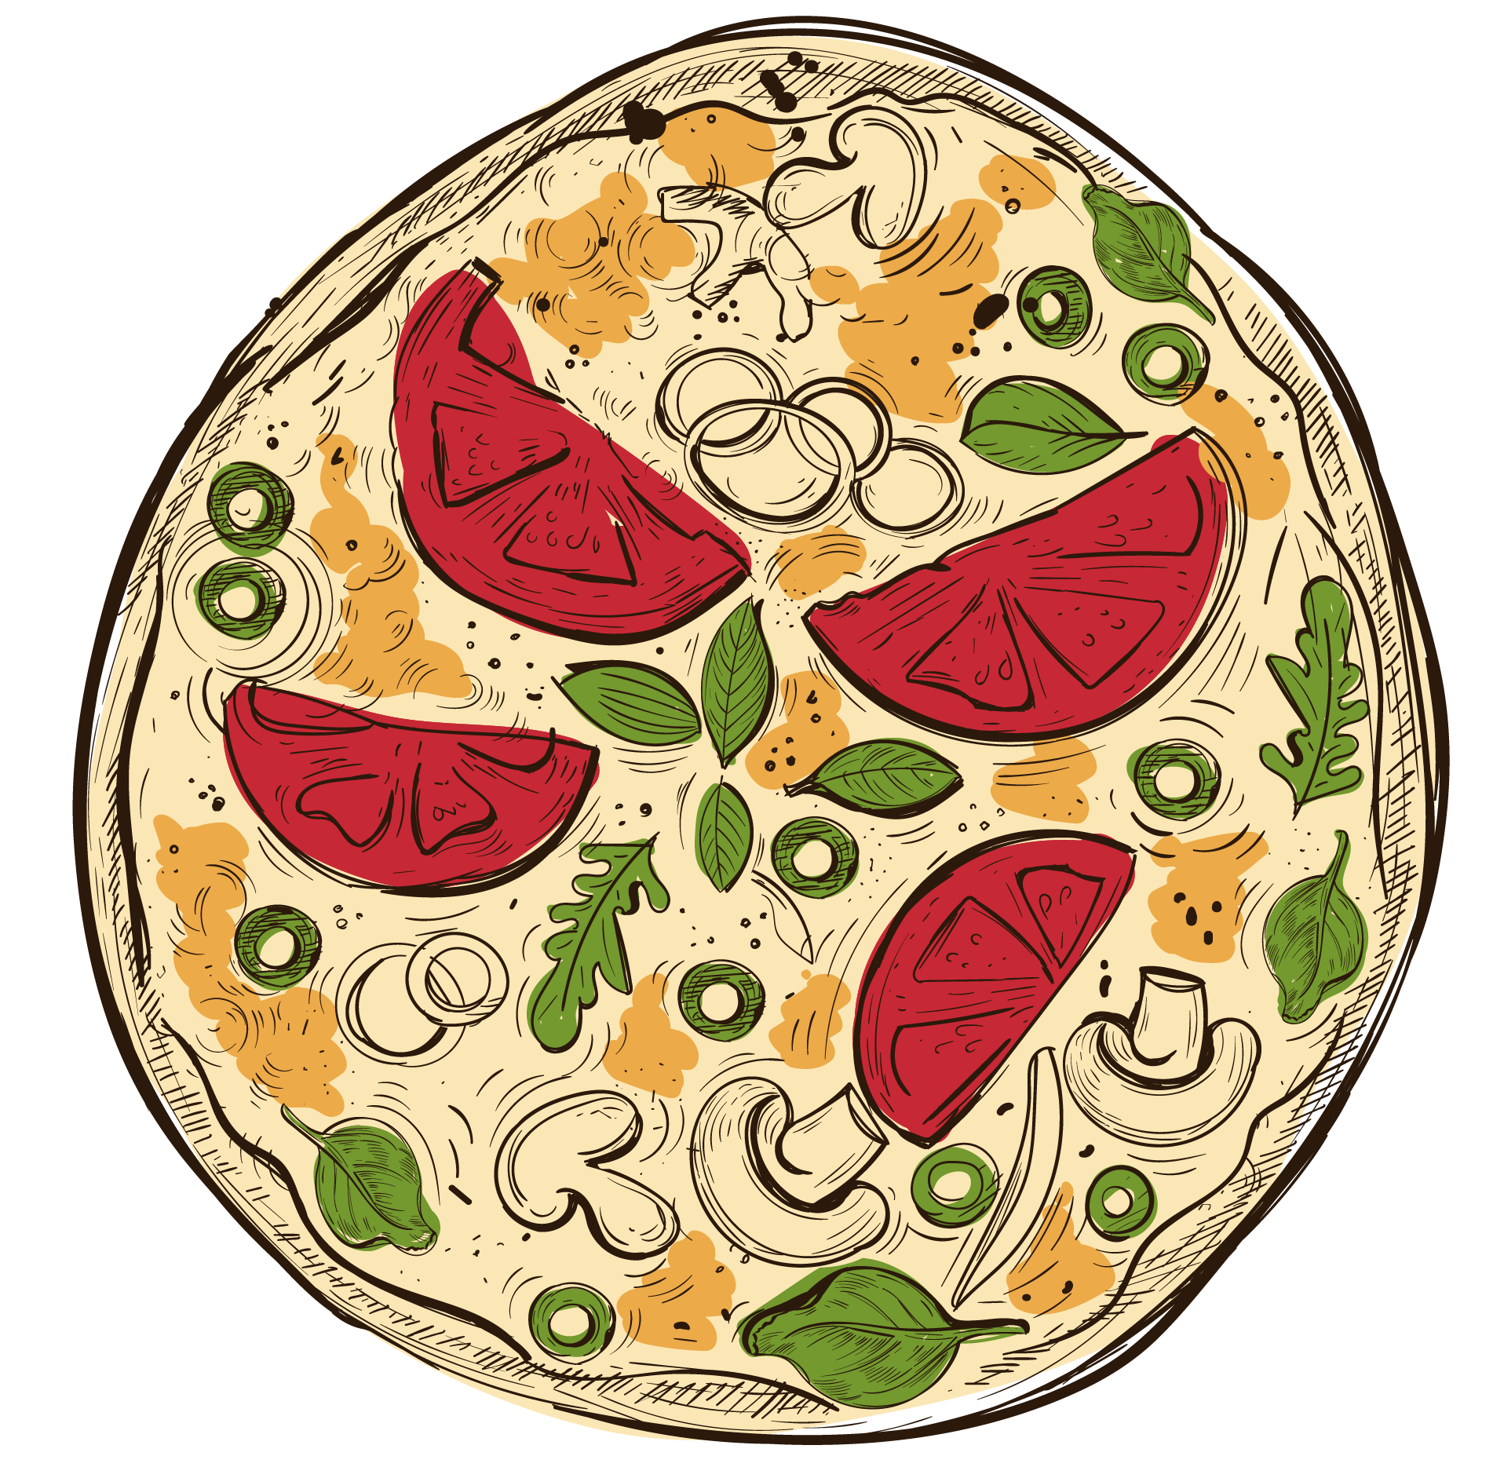
THANKS!

